Slide 1



CREATING
CLASS AND MODULES
IN PYTHON
Priestly Bulan Lobo

Slide 2
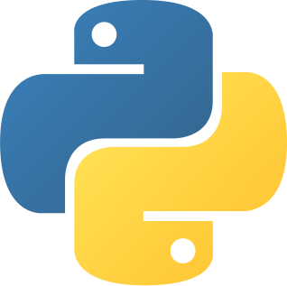
CREATING
CLASS IN PYTHON

Slide 3

CLASS
A class is a template definition of the methods and variables in a particular kind of object.
.

Slide 4
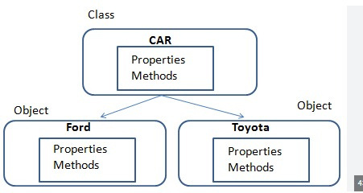

Slide 5
Creating
Python Modules

Slide 6
WHAT IS MODULES
A module is a file containing Python definitions and statements.

Slide 7

“programming is not how to make us understand but how to make the computer understand”

Slide 8

THANKS!
Do you have any questions?
lobopb23d@student.unhas.ac.id
+62-813-5561-6159
priestlybulanlobo.site

